Slide 1
Signaling the Health of Tree-pit Soil
EECS E4764 Fall ‘19 IoT - Intelligent Connected Systems
Group 12, Members:
Chengye Yang
Haokai Zhao
Zhuoyue Xing

Slide 2

Background
The general importance of the water infiltration rate of urban soils to stormwater management
Urban land surface coverage:
Largely covered by buildings, pavement, parking lots and other impervious surfaces
A typical city block generates five times as much runoff during wet-weather flow than a woodland of the same size
Urban street trees divert urban stormwater:
Interception, stemflow, infiltration
Infiltration: water enters the ground via the tree-pit soil (in the presence of tree-pits)
The infiltration capacity of the tree-pit soil modulates the street trees’ ability to mitigate stormwater runoff, which in turn is a function of soil system health
Photo Credit: J. Allen Frame
Notes:
This runoff: lead to local water body pollution
The general importance of the water infiltration rate of urban soils to stormwater management

Slide 3
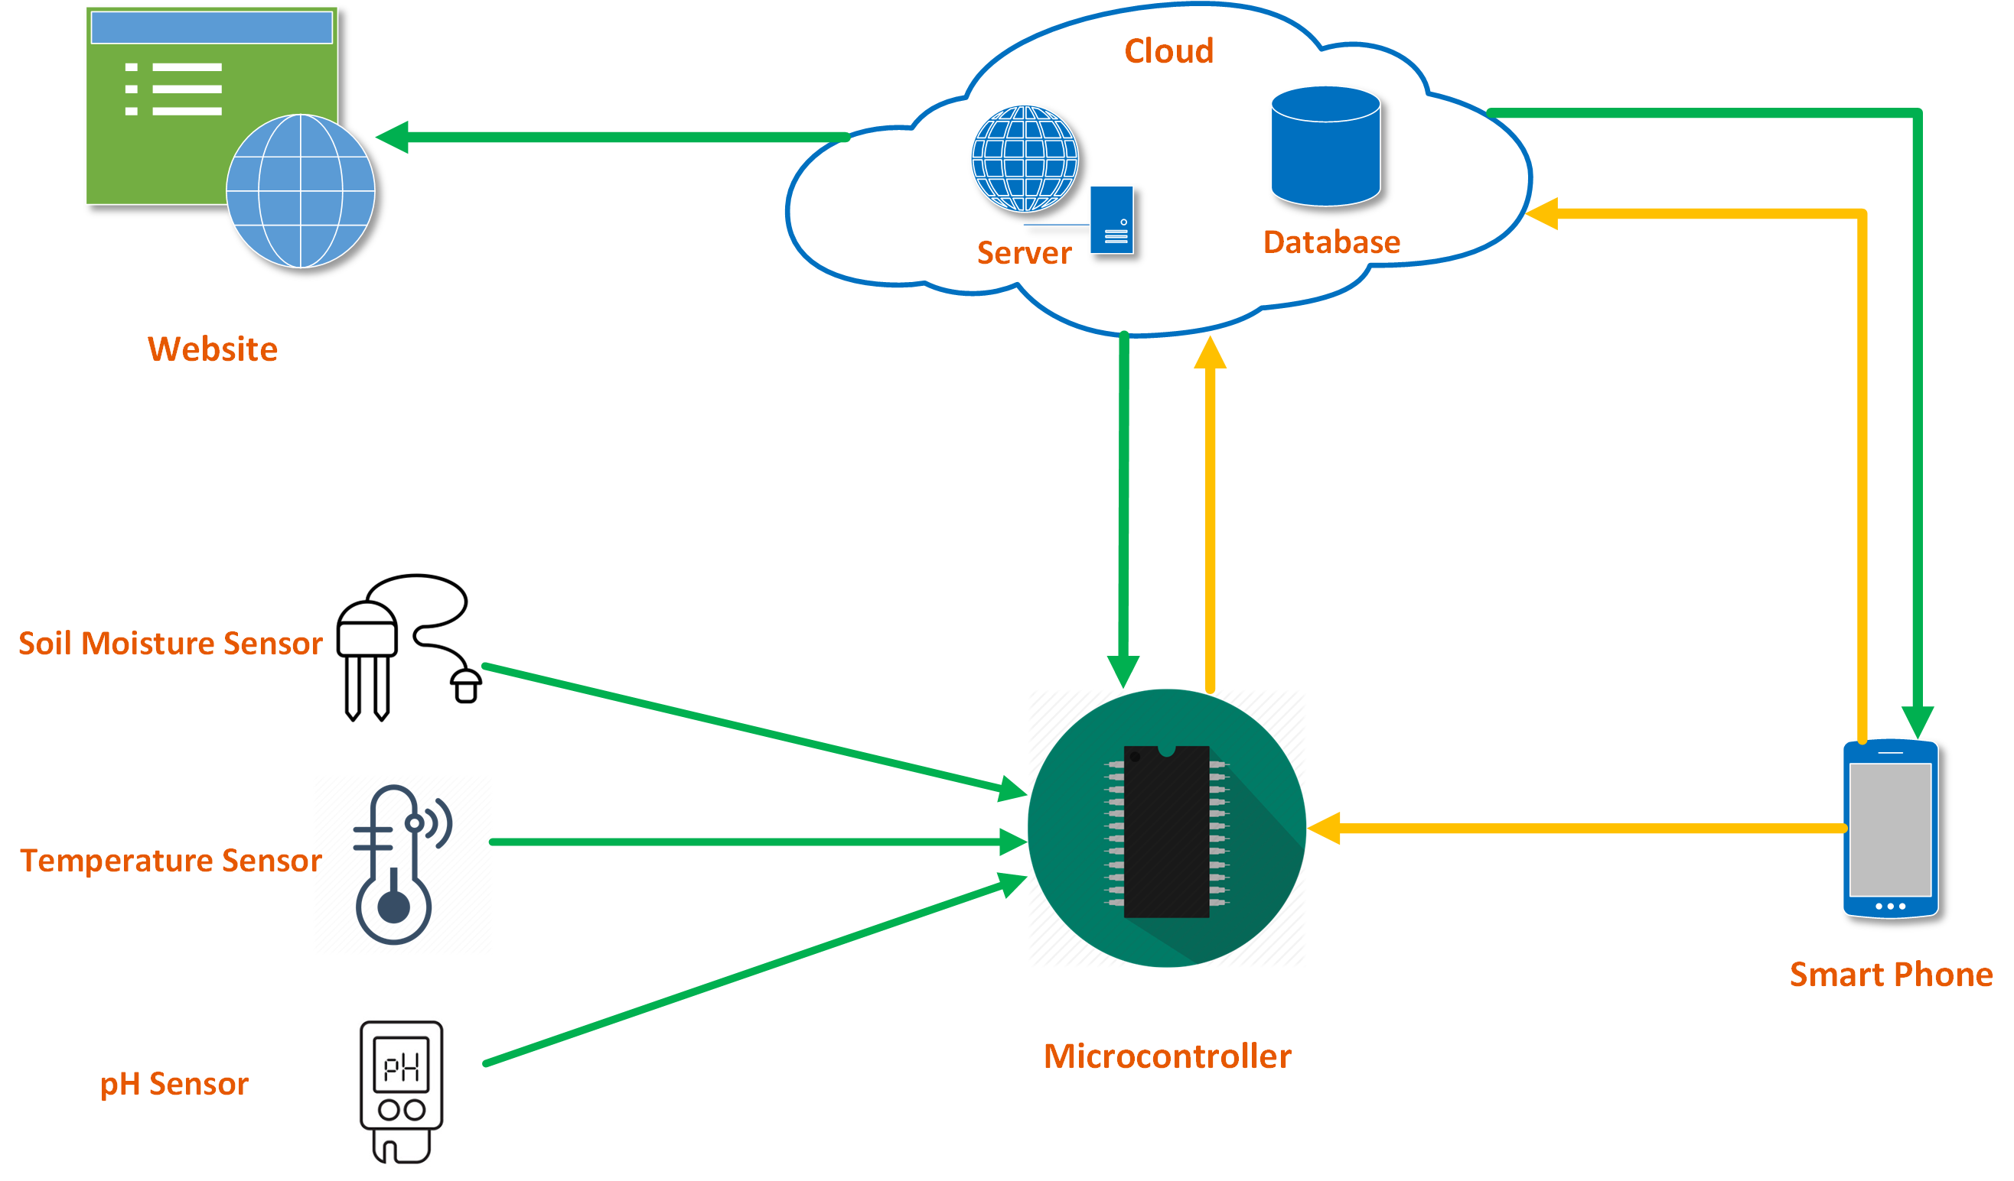
System Diagram

Slide 4
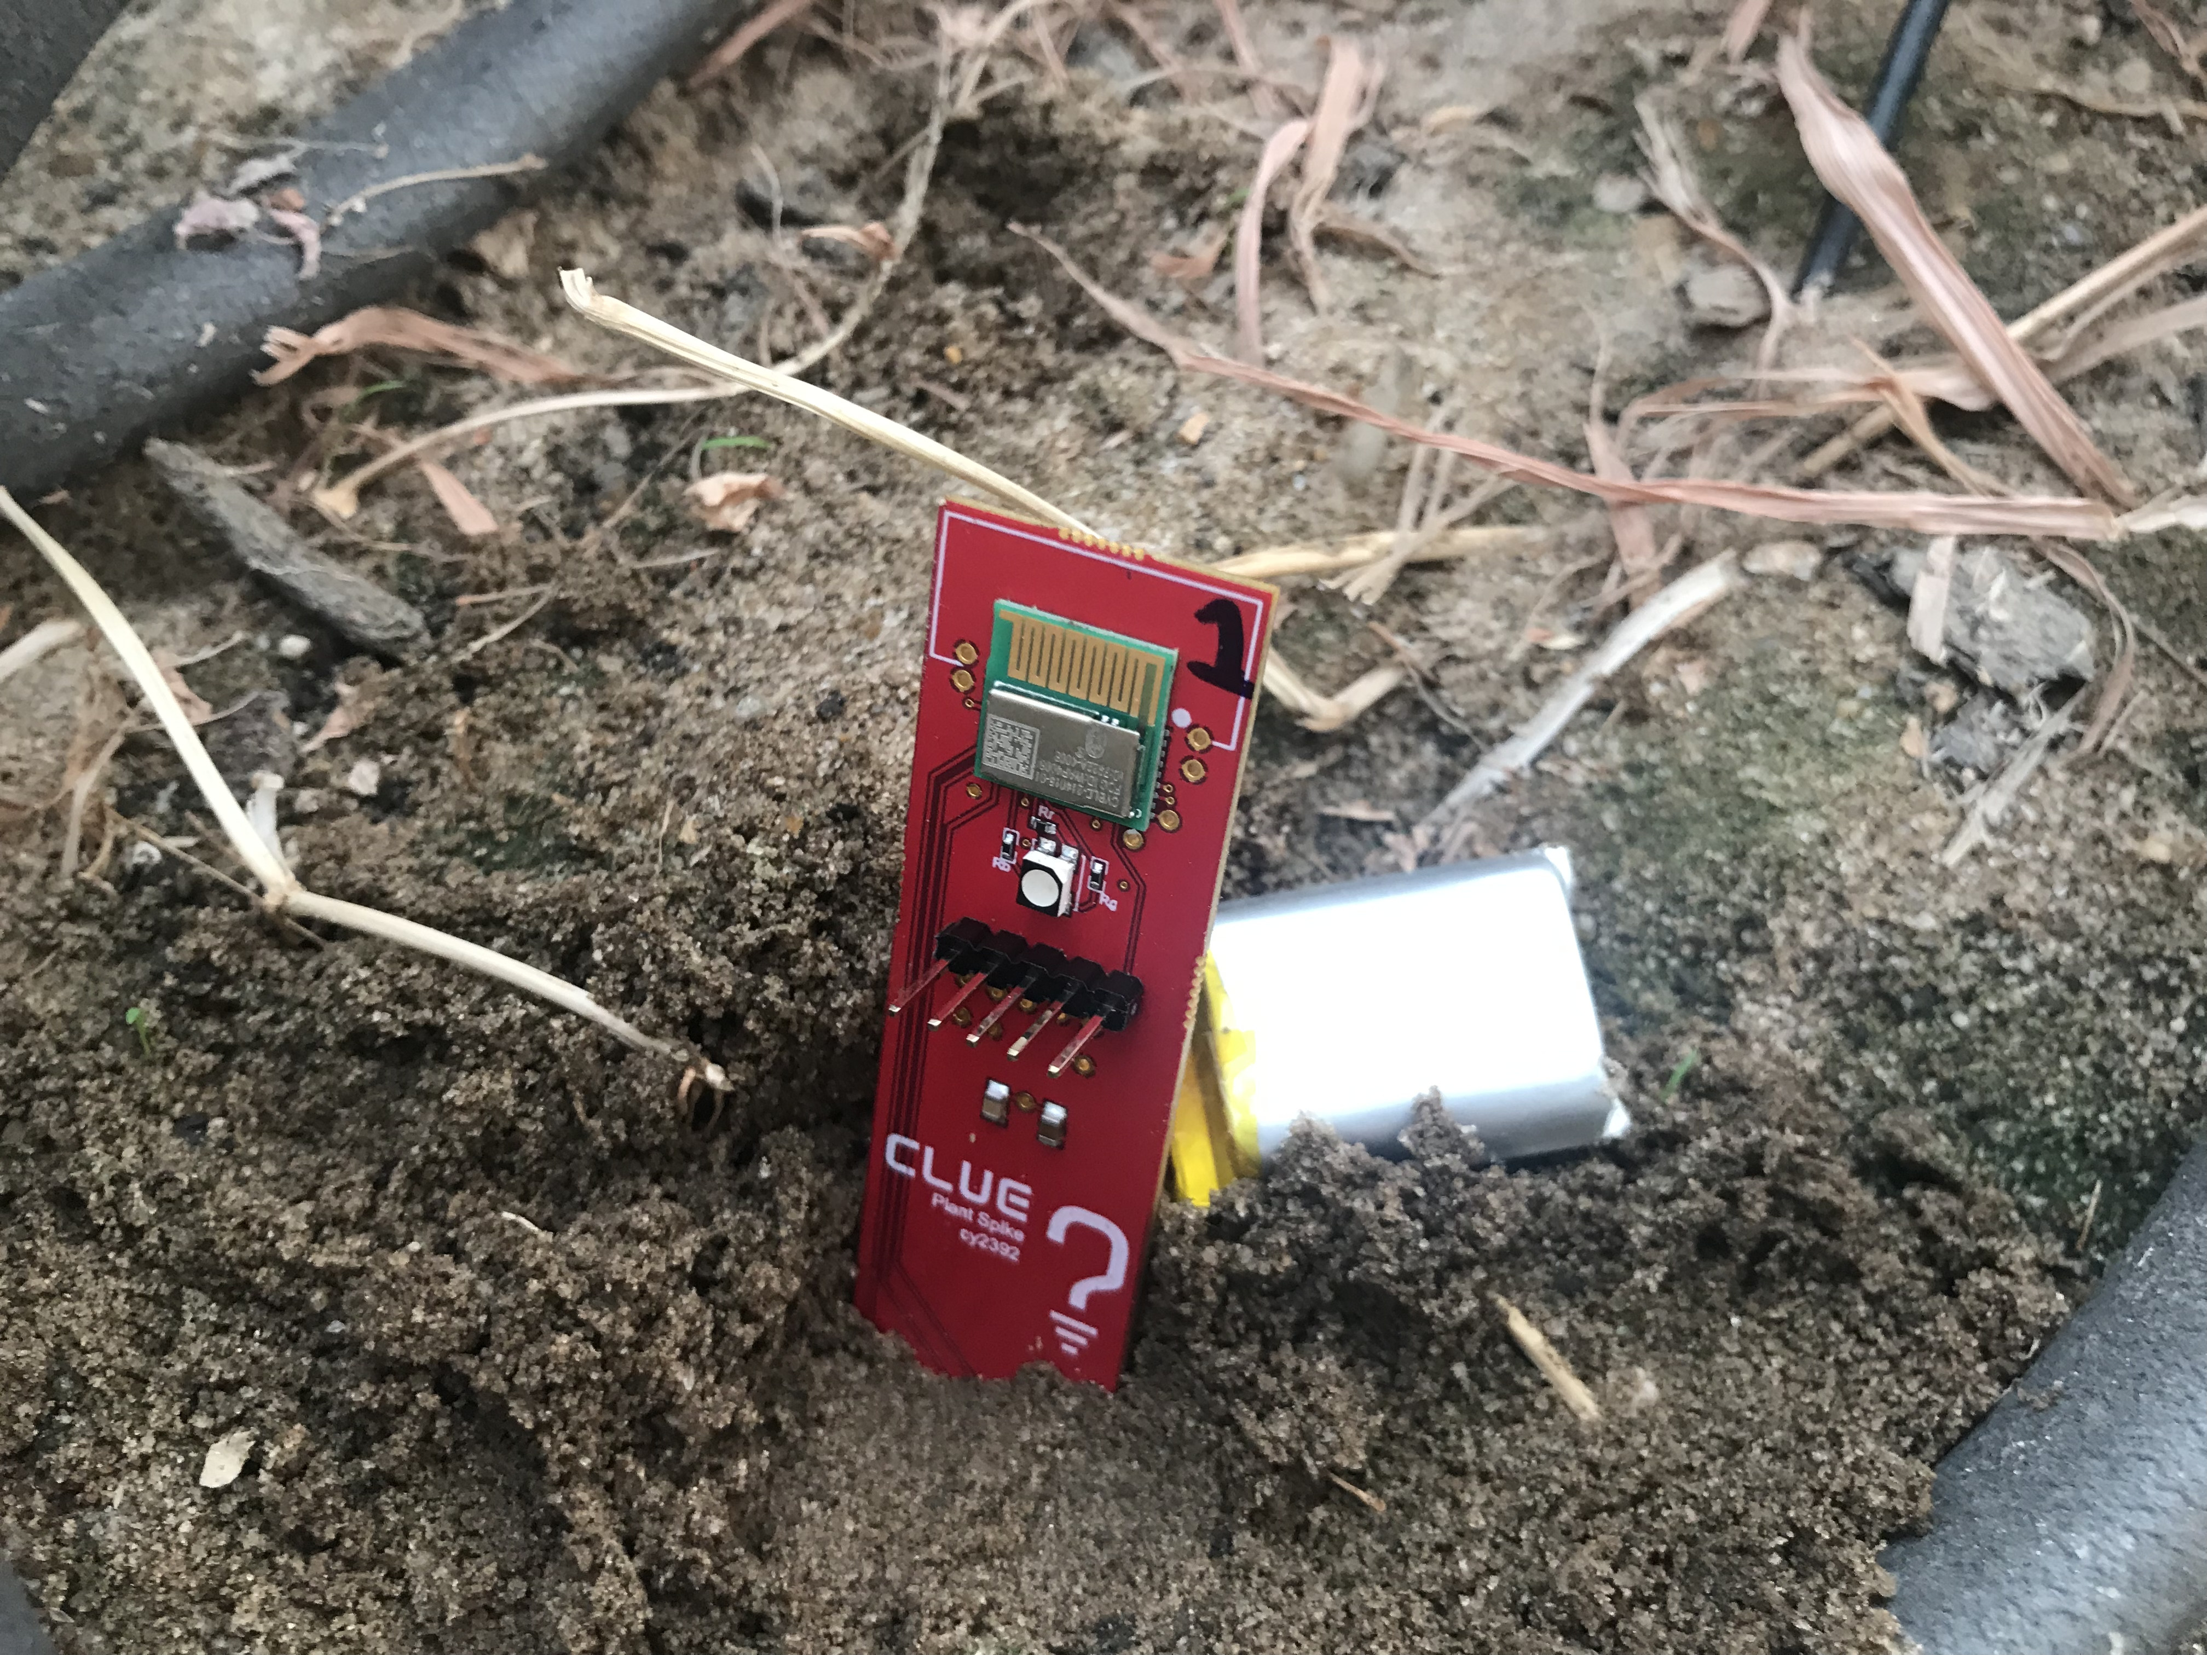
Outcomes
Standalone sensor unit:
Measures soil moisture, temperature, pH
Bluetooth communication
Low power, low cost
Citizen engagement
Current limits:
Only has moisture and temperature
Transmission range
Waterproof design
…

Slide 5
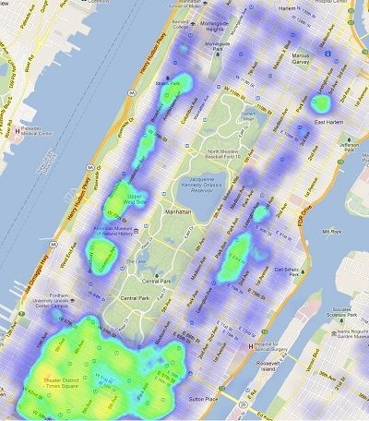
Outcomes
Operation Dashboard:
Send command to sensor
Download formatted data
Single unit:
Time series of the measured parameters
Multiple units deployment:
Spatial distribution of the measured parameters
Heat map
Photo Credit: dfkoz

Slide 6
Signaling the Health of Tree-pit Soil
EECS E4764 Fall ‘19 IoT - Intelligent Connected Systems
Thank you!
Any questions or suggestions?

